Slide 1

Hacking 200
Lesson 1: Introduction to Cloud Technologies

Slide 2
What to Expect?
Purpose of Hacking 200
Focus will shift from being able to understand security problems to actively finding them
Hacking 100 taught security basics, introduction to the hacker mindset, and was designed to give students the fundamental knowledge and skills necessary to recognize security problems.
Hacking 200 continues to focus on Penetration Testing a real world application while introducing new technologies and advanced techniques with a focus on cloud infrastructure.

Slide 3
What to Expect?
Course Content
Lesson 1: Introduction to Cloud Technology | Lesson 2: Using Cloud Technology | Lesson 3: Attacking Cloud Technology
Lesson 4: Threat Modeling | Lesson 5: Network Security | Lesson 6: Reverse Engineering
Lesson 7: Web App Security | Lesson 8: Application Security | Lesson 9: Password Based Security & Denial of Service

Slide 4
What to Expect?
Hacking 200 Goals and Objectives
Upon successful completion of this course, you will be able to:
Describe how basic big data and cloud technology function;
Recognize common security issues in frequently used cloud technologies;
Recognize and describe flaws in applications and services designs;
Demonstrate methods of bypassing common industry security mechanisms and tools (such as AntiVirus and Sandboxes);
Demonstrate the ability to perform basic reverse engineering;
Demonstrate and describe advanced web application security techniques and concepts, (such as CSRF, cookie injection, etc), for attacking web applications;
Demonstrate and describe the process of code review for finding common flaws in application code;
Describe the science behind password security and issues; and
Describe common denial of service attack techniques and safeguards.

Slide 5
Objectives
After this lesson, students will be able to:
Begin applying analysis skills to an unknown application for a Penetration Test;
Describe the differences between traditional hosting versus cloud technologies;
Describe the basic structure of Hadoop;
Describe MapReduce and common implementations;
Describe the basic infrastructure behind services offered in AWS and Microsoft Azure; and
Define commonly used terms and abbreviations.

Slide 6
Review – Pentesting Process
Pre-engagement interactions
Intelligence gathering
Threat modeling
Vulnerability analysis
Exploitation
Post exploitation
Reporting

Slide 7
Review – What makes a “good” pentester?
Depends whom you talk to
Depends on what specific discipline
For our purposes we mean loosely application security and related fields
Mindset - Strong attacker's mindset
Perseverance – Ability to tread into the unknown and make sense of things
Knowledge - Strong foundational knowledge of “everything”
Threat Modeling - Great at threat modeling, quickly consume and digest designs
Notes:
Mindset - Strong attacker's mindset
Need to be able to appropriately question all things
Always be asking why and how
Does not mean “never trust”, but with more experience develop an appropriate bar or what is assumptions vs reality (comment on personal experience: e.g: found bugs in .net)
Always things of problems from multiple angles and points of view
How can I abuse this?
Who cares and does not care?
What can be added to the equation to change its outcome?
Perseverance – Ability to tread into the unknown and make sense of things
Be able to “just figure it out”
what happens when you have to test something not seen before?
Use experience to relate to things/concepts you know and to figure out when your knowledge stops
Use experience to form a strategy to understanding the end to end of everything
Most importantly, being comfortable with being uncomfortable
Knowledge - Strong foundational knowledge of “everything”
It is important to be able to recognize what you are looking at
Know if a attack will work in certain scenarios or not others, same for solutions
All it takes is one small thing to fall our of place for things to go wrong, you need to understand all small things.
Investing into fundamental understandings is one of those things that sets apart the more jr from the more senior folks in specifically ability.
The ones finding the vulns everyone else copies or builds their tools off of, they all got there through a fundamental understanding of how “everything” works
What do I mean by everything? OS, network, protocols, computers, internet, expectations, etc etc
Of course there are specializations and sme, but not a excuse for skipping over atleast a basic understanding of how everything fits together
Of course not one can know “everything”, but the point is you strive for it and security is a lifelong profession of always always always learning. Sometimes reading, sometimes experimenting, always learning.
Threat Modeling - Great at threat modeling, quickly consume and digest designs
Directly tied into proficiency in finding both a good spread and depth of issues
You don’t find significant issues by blindly pounding on a application.
Even with fuzzing there is “smart” and “dumb” fuzzing, and pentesting is not fuzzing
Need to be able to quickly understand designs and security contracts (intent/expectations)
Need to be able to follow, mentally, from start to finish of what happens to the data and what happens in the application.
Use experience and knowledge to fill in gaps
Basically come up with a mental strategy for a attack plan for places that are more or less vulnerable
Be able to mentally and quickly reason out what is a good or bad use of time
Come up with a variety of ideas to try out
Have “some” kind of idea of how to go about attacking the application simply based on design

Slide 8
Continued – What makes a “good” pentester?
Quick mental exercise, “Hack” this sentence.
Goal: get as much money as possible
Rules:
“vulnerability” - able to modify (change or delete) one word
“exploit” - Sentence must make some grammatical sense (English) for the attack to execute properly
“Please give me 50 dollars in a stack and 50 cents in a role” = $50.50
possible answer (a): “Please give me 50 dollars in a stack and 50 cents in a role” = $100
possible answer (b): “Please give me 50 dollars in a stack per 50 cents in a role” = $1000 to $2500
possible answer (c): “Please give me 50 dollars in a stack and 50 cents in each role” = $???
Notes:
Let do a quick mental exercise to emphasize some of the qualities we just talked about
Explain the rules and give everyone a minute to think about it and answer if they would like. Classroom participation is welcome
(before going over answers)
What is really important is not going to be the answers themselves, but really pay attention to what it “takes” to be able to come up with and understand these answers.
When I first asked you to attack the sentence what went through your head?
Did you assess what you knew and did not know
Did you form a strategy for what “things” you could abuse?
Did your mind hone in on specific key words or parts?
What knowledge and fundamental understandings/grasps were necessary?
A number of the qualities of a good pentester are not very different from solving XYZ problem in other parts of life, it’s a matter of having that same level of proficiency in this new “area” you spent your entire life building up. Or atleast a level of effort and drive approaching that, you get as much out as you put in.
Would you have been able to recognize the significance of a behavior you observed? For example seeing the word “please” get deleted, would you have then started to form the same “strategy” given that as your only hint?
Possible answer (A)
You can get 100$ by deleting the word “cents”. This takes away the describing the second “50” as cents and forces an assumption that you want two sets of 50$.
(-important-) need to understand English, grammar, and basic US monetary values
Possible answer (B)
You can get $1000 dollars up to $2500 by replacing the word “and” with “per”
Quarter “role” has 40 quarters adding up to $10.00
Half-Dollar “role” has 20 half dollars adding up to $10.00
One Dollar “role” has 25 dollar coins adding up to $25.00
(-important-) need to understand English, grammar, and basic US monetary values + (math, addition, multiplication, and various ways to represent multiplication in different forms: “per”)
Possible answer (C)
You can get some undefined amount of money by replacing the word “a” with “each”.
The total amount of “roles” are not described in this sentence, so logically, at this point in time its undefined and open ended.
(-important-) need to understand English, grammar, and basic US monetary values + (math, addition, multiplication, and various ways to represent multiplication in different forms: “per”) + (logic of the larger “story”, expectations of people involved, etc)
Some final take away lesson on this topic.
Don’t undervalue how essential understanding how things work is to being an effective attacker
Don’t underestimate how valuable understanding the large picture is such as security contracts, specifically what is the expectations and intent of things.
Practically – it will be super obvious during a technical interview how much well you understand something and how much hands-on knowledge you have.
Questions, as they get harder, are things like an application of knowledge (e.g.: why doesn’t this fix work or when would this attack work)
Hands on knowledge is obvious if you can’t answer what should be a very simple question if you experience it firsthand before or skipped over it. (e.g: what does a wet dog smell like?)or(how do you typically structure your XSS payload and a proof of concept and why?)
Hopefully clear the point isn’t to scare or make this sound impossible, its you get out at much as you put in

Slide 9

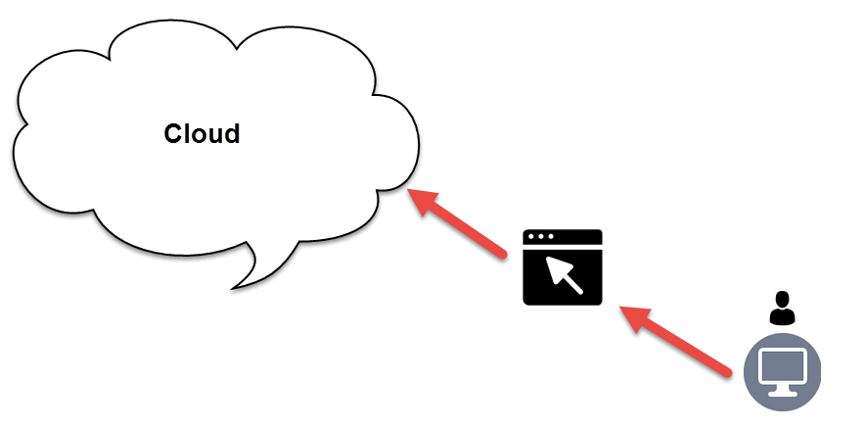
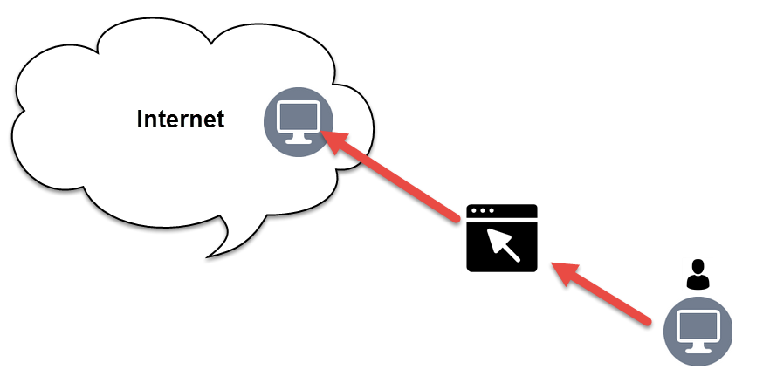
The Cloud
Not much different from:

Slide 10
What is “cloud”?
Very large term but also very over loaded.
Most people mean “cloud computing” but you never hear the “computing” part.
Being able to do computing over a network (will go into more depth in lesson 3)
Software as a Service - SaaS
(Office, CRM, CMS,...)
Platform as a Service - PaaS
(Web Server, Hadoop, Database,..)
Infrastructure as a Service - IaaS
(Servers, VMs, Basic Storage,..)
Notes:
Cloud isn’t virtualization, that is a means or tool to enable cloud scenarios
Cloud isn’t storage over the internet, that is simply apart of it
Cloud isn’t even processing data over the internet, that is also simply a single part of it
As a whole marketing and many individuals loosely throw around the word “cloud” to describe single aspects of a larger story.
Cloud is anything that enables “computing” over a network. While its not glamorous, if you connect two laptops together via an ethernet cable or connection, you have your own personal “cloud”.
However the “context” of what most people are referring to when they say cloud is specifically referring to the “computing” part.
Some may imply “storage” of data on a network or “processing” of data on a network. A lot of this is due to marketing and cultural trends, when we think clouds for many that means amazon, azure, ec2, google drive, etc.
But what is google drive for example, its is data storage. How is it different logically from storing something locally? Only the fact that its not local.
Why make this differentiation? – language, but its important to understand specifically “expectations”.
If the point of “cloud” is to accomplish a variety of computing tasks over a network, then the right question to ask is what is the specific task?
Based on the specific task or tasks, what is then your security expectations?

Slide 11
Why talk about cloud specifically?
Very relevant to the industry today
Also
Pentesting Proccess:
Pre-engagement interactions
Intelligence gathering
Threat modeling
Vulnerability analysis
Exploitation
Post exploitation
Reporting
What makes a good pentester:
Mindset - Strong attacker's mindset
Perseverance – Ability to tread into the unknown and make sense of things
Knowledge - Strong foundational knowledge of “everything”
Threat Modeling - Great at threat modeling, quickly consume and digest designs
First step: Understand the original driving force, the original “task”, and design ancestor of the cloud ecosystem for the industry – “big data”
Notes:
“cloud” is the trend for very huge portions of the industry
Pentesting process:
Ties into the pentesting process, we need to understand what exactly we are testing
We need to be able to understand the security contract, the expectation, to point out violation of that expectation
We need to understand what technology goes in to be able to pull out technical flaws or vulnerabilities
What makes a good pentester:
Mindset – understanding how things work so we can be creative in abusing them
Perseverance – many designs will stem off these concepts, give you the ability figure things out in the unknown
Knowledge – foundational knowledge starts with origins; we need to understand “cloud” before we can attack a product based on cloud technology
Threat Modeling – Being comfortable with these cloud “concepts” makes is easy to follow the threads of risky behavior in related but new designs
This is building the foundations to be a good pentester.
Why big data? - It was the desire to be able to “search” a “big” amount of data, which was beyond the resource limits of a single computer at the time, which forced researchers to turn to cloud computing.
- Technology today have advanced farther than what we will talk about, but the core concepts will stay the same. (e.g: distributed xyz, resource managers, gateways, etc)
Let understand what was part of the original designs
Understand the original intent
Understand the original flaws, baked in, that the industry is still solving to this day (lesson 3)

Slide 12
Why talk about cloud specifically? - continued
What makes a good pentester:
Mindset - Strong attacker's mindset
Perseverance – Ability to tread into the unknown and make sense of things
Knowledge - Strong foundational knowledge of “everything”
Threat Modeling - Great at threat modeling, quickly consume and digest designs
It is important to remember that technology changes constantly, what is “more” consistent are the concepts. Obtaining a firm grasp of the concepts makes you much more proficient in your lifelong job of always learning new technologies.
Notes:
It is important to remember that technology changes constantly, what is “more” consistent are the concepts. Obtaining a firm grasp of the concepts makes you much more proficient in your lifelong job of always learning new technologies.
The technology at hand is less relevant, we could be talking about something from the beginning of the internet.
Hadoop is simply a great example and historical starting point of where distributed systems got momentum for the industry
As we go through this material pay close attention to the concepts, ask questions if you need to.
In
Lesson 1 – high level overview & concepts
Lesson 2 – Lower level understanding of specific pieces of technology and how to use them
Lesson 3 – More in-depth of the security specific side of this all

Slide 13
History of Hosting -> Cloud
Traditional Hosting
Secured (depending on the type of OS that the service runs on).
Administration varied depending on the OS.
Dedicated or co-located: Full control over software and hardware components. Required a physical racked server. Typically allows for root or administrative access.
Shared hosts: Sometimes multiple applications and domains would run on the same physical server without any type of isolation. Only the hosting admins would have root/admin access.
Virtual Private Server (VPS) Hosting / Infrastructure as a Service (IAAS)
Full control over the software with root/admin access.
No longer in control over the hardware.
Secured by the hosting provider, security for software up to customer.
Emulates a dedicated server.
Cloud Hosting / Platform as a Service (PAAS)
Full control over the software with root/admin access.
Infrastructure is secured by cloud provider, operating system and blow is meant to be secured by the tenant.
Use of virtualization and shared tenancy on the same physical host; isolation provided by the virtualization software.
Easily scale resources to meet demands of users.
Horizontally – Bigger hardware, more VCPUs, more memory.
Vertically – Distribute load across multiple servers to maintain high availability.
Managed services like databases, email, messaging queues, workflow, artificial intelligence.
Notes:
The first logical place to start is talking about the infrastructure level.
In all “offerings” of IAAS, PAAS, and SAAS there are some assumptions of responsibility of infrastructure being made.
Even before modern offerings, there are different classical profiles which have some overlap and tell a unique story of responsibility and expectations around hardware.
Traditions – host my physical server for me
VPS – host my OS on your hardware. This is loosely (IAAS), but modern offerings have evolved.
Cloud Hosting – typically you don’t control the OS, but software running on it. This is loosely PAAS, but modern offerings have evolved.

Slide 14
Big Data
Technology allowing the processing of “big data” close to magical, but still not magic.
2 main “big data” questions today:
How do you store giant amounts of data?
How do you analyze giant amounts of data?
Notes:
Second part of the question of big data.
There was infrastructure or hardware and now the application side.
On the application side we have much more data focused questions.
Without “cloud” and big data, how do we search data?
In a simple example
store a file on a local disk.
Open it with a program or some code
Search that file from top to bottom
Spit out the result when found
How do we escape the limits of typical machine/computer?

Slide 15
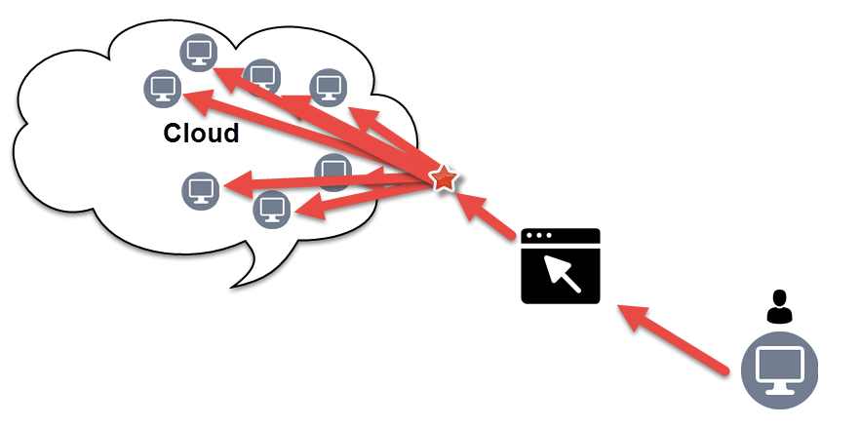

How to store giant amounts of data?
If one computer isn’t enough use 2… or many.
= ?

Slide 16

=
http://hadoop.apache.org/
“The Apache™ Hadoop® project develops open-source software for reliable, scalable, distributed computing.
The Apache Hadoop software library is a framework that allows for the distributed processing of large data sets across clusters of computers using simple programming model.”

Slide 17
=
3 main components of Hadoop:
Hadoop Distributed File System (HDFS™): A distributed file system that provides high-throughput access to application data.
Hadoop YARN: A framework for job scheduling and cluster resource management.
Hadoop MapReduce: A YARN-based system for parallel processing of large data sets.

Slide 18
How to store giant amounts of data?
If one computer isn’t enough use 2… or many.
= Hadoop Distributed File System (HDFS™)

Slide 19

HDFS – How does it work?
Officially:

Slide 20
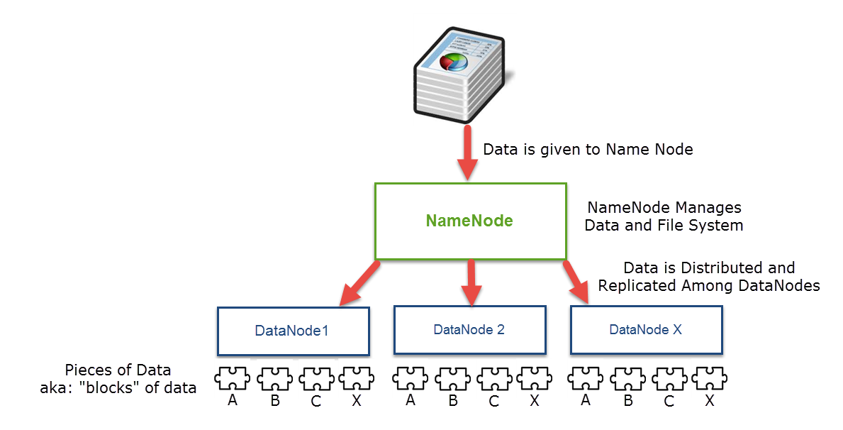
HDFS – How does it work?
Simplified:

Slide 21
HDFS – How does it work?
Overall Details:
HDFS …
Stores data in blocks on the various nodes in the Hadoop cluster (typical block size is 128MB)
Replicates data blocks and distributes them in a way which is reliable and can be retrieved fast (every data block is replicated across multiple nodes in cluster)
NameNode manages file system and related metadata
Reading Data goes through NameNode, NameNode will talk to DataNodes to get blocks of data

Slide 22
How to analyze giant amounts of data?
Again, if one computer isn’t enough use 2… or many.
= Hadoop MapReduce

Slide 23
Map Reduce – What is it?
Where does the name come from? … Programming!
Map: “is a higher order function that applies a given function element-wise to a list of elements and returns a list of results.”
aka: [For every piece of data do something with it and return the result]
Reduce: “is a higher order function that processes a list of elements in some order and build up a return value.”
aka: [For all results, put them all together into one result]
Map Reduce = Processing of data in parallel to find a result

Slide 24
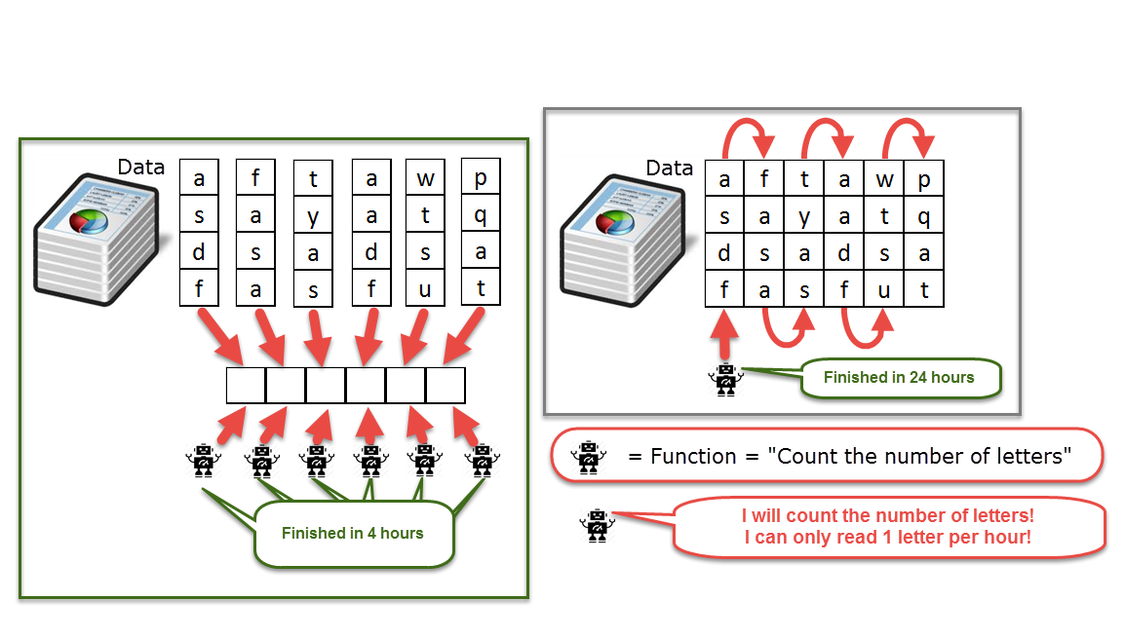
Map Reduce – How does it work?
The power of “Map” – Parallel vs Sequential
Map: “is a higher order function that applies a given function element-wise to a list of elements and returns a list of results.”
aka: [For every piece of data do something with it and return the result]
Sequential:
“Map”/Parallel:

Slide 25
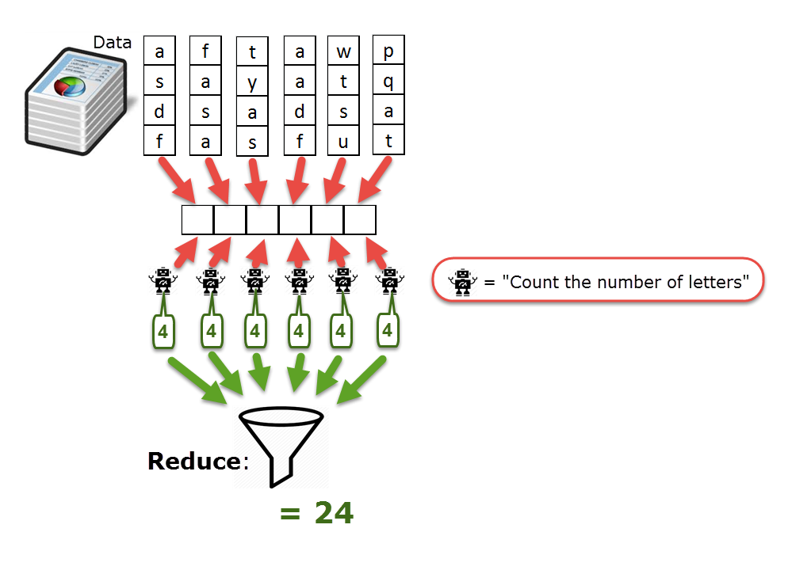
Map Reduce – How does it work?
Reduce: “is a higher order function that processes a list of elements in some order and build up a return value.”
aka: [For all results, put them all together into one result]

Slide 26
Mini Exercise!
Can you put the pieces together?
You now know of HDFS & Map Reduce
Questions – How might these pieces work/fit together? What would make it possible for them to work together?
Feel free to discuss with other students, type your response in the chat window.
The point is critical thinking! So if you know the answer already without having to figure it out, please give everyone else a chance to think about it ☺

Slide 27
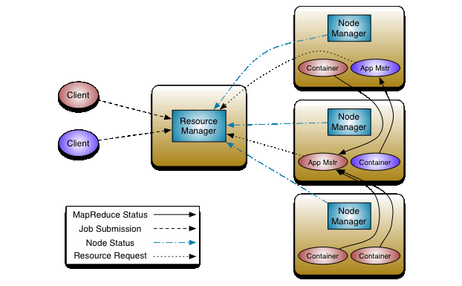
YARN – What is it?
YARN “Yet Another Resource Negotiator”
“The fundamental idea of YARN is to split up the functionalities of resource management and job scheduling/monitoring into separate daemons. The idea is to have a global ResourceManager (RM) and per-application ApplicationMaster (AM). An application is either a single job or a DAG of jobs”
aka: YARN is a overall system, a system in which there are separated duties. There is a process/someone to manage resources and someone else to keep track of job scheduling and monitoring.

Slide 28

YARN – How does it work?
Don’t forget – no magic involved - The overall concept is simple!

Slide 29
YARN – How does it work?
YARN “Yet Another Resource Negotiator”
http://hadoop.apache.org/docs/current/hadoop-yarn/hadoop-yarn-site/YARN.html
“ResourceManager is the ultimate authority that arbitrates resources among all the applications in the system”
“NodeManager is the per-machine framework agent who is responsible for containers, monitoring their resource usage (cpu, memory, disk, network) and reporting the same to the ResourceManager/Scheduler.”
“ApplicationMaster is per-application (job), and in effect, a framework specific library and is tasked with negotiating resources from the ResourceManager and working with the NodeManager(s) to execute and monitor the tasks.”
Notes:
A container is an abstract notion in YARN platform.
It represents a collection of physical resources. Also could mean CPU cores, disk along with RAM.
When an application is about to get submitted into the YARN platform, the YarnClient allocates a container from the ResourceManager, where its ApplicationMaster will run (container 0).

Slide 30
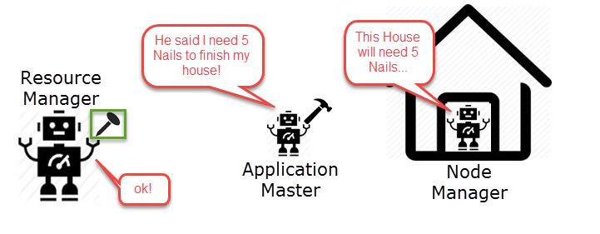
YARN – How does it work?
YARN “Yet Another Resource Negotiator”
“ResourceManager is the ultimate authority that arbitrates resources among all the applications in the system”
“ApplicationMaster is per-application (job), and in effect, a framework specific library and is tasked with negotiating resources from the ResourceManager and working with the NodeManager(s) to execute and monitor the tasks.”
“NodeManager is the per-machine framework agent who is responsible for containers, monitoring their resource usage (cpu, memory, disk, network) and reporting the same to the ResourceManager/Scheduler.”
http://hadoop.apache.org/docs/current/hadoop-yarn/hadoop-yarn-site/YARN.html

Slide 31
Other Hadoop Components
http://hadoop.apache.org/
Other Hadoop-related projects at Apache include:
Ambari™
A web-based tool for provisioning, managing, and monitoring Apache Hadoop clusters which includes support for Hadoop HDFS, Hadoop MapReduce, Hive, HCatalog, HBase, ZooKeeper, Oozie, Pig and Sqoop. Ambari also provides a dashboard for viewing cluster health such as heatmaps and ability to view MapReduce, Pig and Hive applications visually along with features to diagnose their performance characteristics in a user-friendly manner.
Avro™
A data serialization system.
Cassandra™
A scalable multi-master database with no single points of failure.
Chukwa™
A data collection system for managing large distributed systems.
HBase™
A scalable, distributed database that supports structured data storage for large tables.
Hive™
A data warehouse infrastructure that provides data summarization and ad hoc querying.
Mahout™
A Scalable machine learning and data mining library.
Pig™
A high-level data-flow language and execution framework for parallel computation.
Spark™
A fast and general compute engine for Hadoop data. Spark provides a simple and expressive programming model that supports a wide range of applications, including ETL, machine learning, stream processing, and graph computation.
Tez™
A generalized data-flow programming framework, built on Hadoop YARN, which provides a powerful and flexible engine to execute an arbitrary DAG of tasks to process data for both batch and interactive use-cases. Tez is being adopted by Hive™, Pig™ and other frameworks in the Hadoop ecosystem, and also by other commercial software (e.g. ETL tools), to replace Hadoop™ MapReduce as the underlying execution engine.
ZooKeeper™
A high-performance coordination service for distributed applications.

Slide 32
Zoo Keeper
“ZooKeeper: Because coordinating distributed systems is a Zoo…”
“ZooKeeper is a centralized service for maintaining configuration information, naming, providing distributed synchronization, and providing group services.”
“ZooKeeper aims at distilling the essence of these different services into a very simple interface to a centralized coordination service.”
https://cwiki.apache.org/confluence/display/ZOOKEEPER/Index

Slide 33
Mini Exercise!
What does Zoo Keeper do?
What role does it play in a Hadoop Cluster?
Where might it fit in to a Hadoop Cluster?
The point of this exercise? With your basic understanding of “cloud” technology, you will be able to figure out how various components fit in.
Feel free to discuss with other students, type your response in the chat window.
The point is also critical thinking! So if you know the answer already without having to figure it out, please give everyone else a chance to think about it ☺
Notes:
Please take this exercise seriously.
Keep in mind we are doing these to reinforce your threat modeling skills.
To be able to draw from concepts you already know about, think critically, and be able to digest and make smart assumptions about new designs.
Its fine if you're not able to come up with an answer, but it is important to ask yourself and identify “why”? What information are you missing? Or what blocking your way?

Slide 34
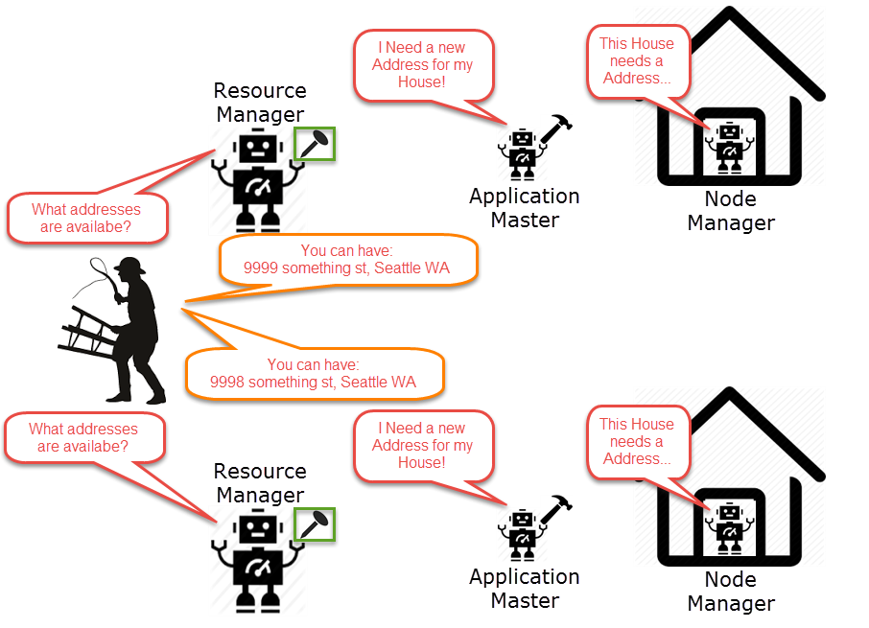
Zoo Keeper handles coordination between distributed systems

Slide 35
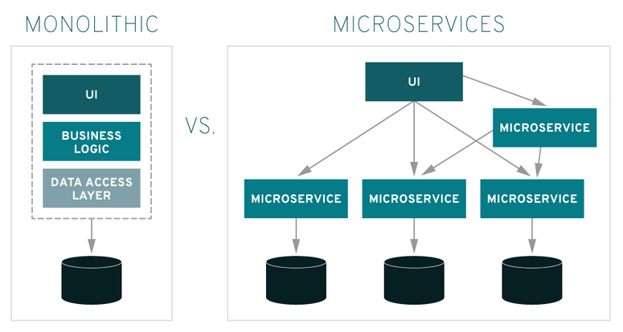
Microservices
Image from: https://www.redhat.com/en/topics/microservices/what-are-microservices
Notes:
Traditionally a cloud native architectural approach
single application is composed of many loosely coupled and independently deployable smaller components, or services.
services typically have their own stack, inclusive of the database and data model;
communicate with one another over a combination of REST APIs, event streaming, and message brokers;
organized by business capability, with the line separating services often referred to as a bounded context.
microservices architectures is that they should feature “smart endpoints and dumb pipes.”
The point is microservices architecture is supposed to be more flexible in the face of the failure of individual components or parts of the network
service-oriented architecture, individual components are relatively tightly coupled, often sharing assets such as storage
Microservices are more independent, share fewer resources, and communicate via more lightweight protocols
Any questions such as why? How? Etc?
The only question I can’t answer is “how does this fit in with distributed systems and related concepts”, that is your homework.

Slide 36
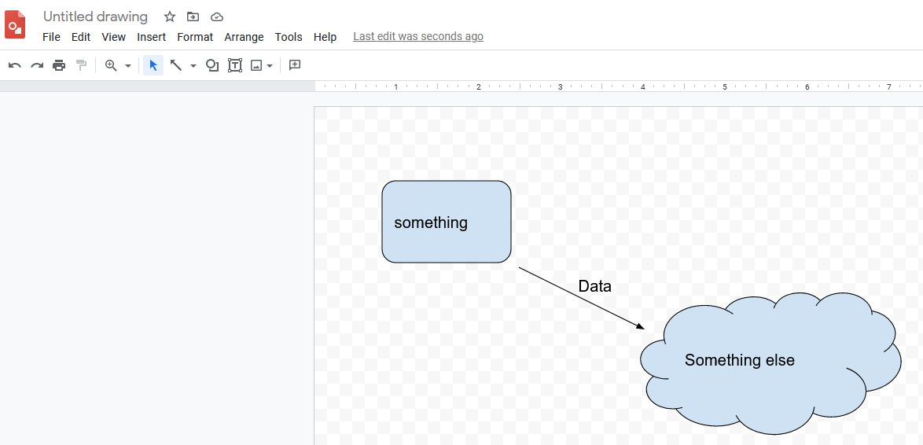
Lets make a diagram
https://docs.google.com/drawings/ (or etc)
Notes:
In your homework you will need to make a diagram.
Let cover this very quickly just incase.

Slide 37
Lab Time!
Questions?
Let me help you on your homework (next slide)

